Slide 1
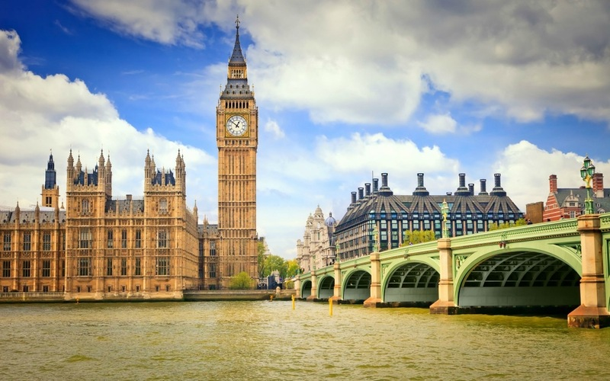
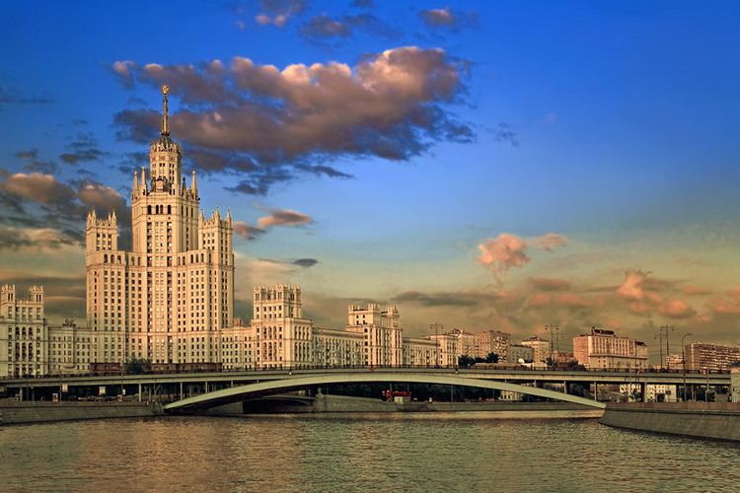
Faces of London and Moscow

Slide 2
Цель урока: совершенствование навыков говорения по теме.
Задачи урока:
Учебный аспект: совершенствовать навыки устной речи, чтения и аудирования, активизировать лексический и грамматический материал по теме “Достопримечательности Лондона и Москвы”.
Развивающий аспект: развивать умения планировать свое речевое поведение; развивать познавательный интерес; развивать творческое мышление, самостоятельность, умения анализировать и оценивать других и себя.
Воспитательный аспект: воспитывать ценностное отношение к культуре своей страны и страны изучаемого языка; воспитывать гражданина, патриота своей страны, развивать национальное самосознание; формировать навыков работы в сотрудничестве.
Личностно-ориентированный: урок способствует созданию условий для повышения интереса к языку и для развития навыков общения и совместной деятельности.

Slide 3
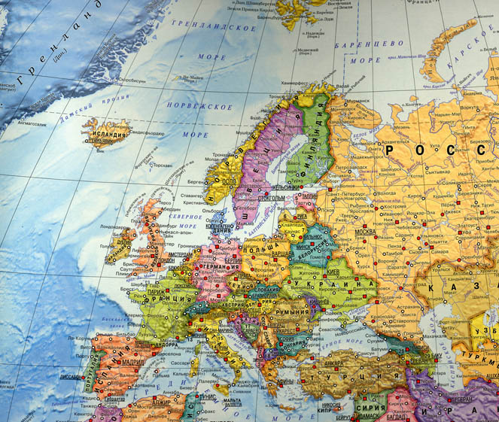
London is the capital of Great Britain and Northern Ireland

Slide 4
It’s population is about 7,5 million people

Slide 5
Moscow is the capital of the Russian Federation

Slide 6
It’s population is about 11,7 million people

Slide 7
The Houses of Parliament – the buildings in which the British Parliament sits.

Slide 10
The tower of Big Ben is a symbol of London and Britain.

Slide 11
Big Ben is really a bell. The bell is over two metres tall and chimes every quarter of an hour.

Slide 12
The Tower of London was a fortress, a royal palace, and a prison for important people. Now it’s a museum.

Slide 13
Special guards look after the Tower and take care of the black ravens that live there.

Slide 14
Westminster Abbey is a gothic church. Many famous British people are buried in the Abbey.

Slide 15
Westminster Abbey was built by King Edward in 1065.

Slide 17
Tower Bridge is the most famous London’s bridge. It was built in 1897.

Slide 18
The Tower Bridge stands on the river Thames.

Slide 19
The London Eye is the giant wheel on the south bank of the Thames.

Slide 20
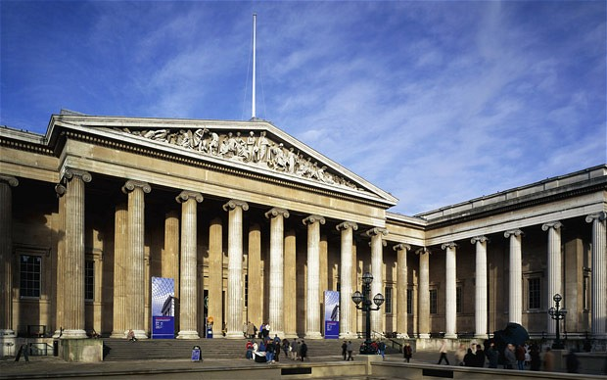
The British Museum is the biggest museum in London. It was founded in 1753.

Slide 21
Buckingham Palace is the home of the British Royal family.

Slide 22
Outside we can watch a colourful ceremony of the Changing the Guard

Slide 23
Red Square is the most famous square in Russia.

Slide 24
“Red” means beautiful.

Slide 25
Saint Basil's Cathedral is a church in Red Square.

Slide 26
It is officially known as Pokrovsky Cathedral

Slide 27
The Kremlin is a historic complex at the heart of Moscow.

Slide 28
It includes five palaces, four cathedrals, and the enclosing Kremlin Wall with Kremlin towers

Slide 29
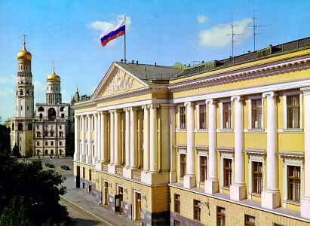
The complex serves as the official residence of the President of the Russia.

Slide 30
The Spasskaya Tower is the main tower of the Kremlin.

Slide 31
It was built in 1491. It’s height is 71 m.

Slide 32
The Bolshoi Theatre is a historic theatre in Russia. It was opened in 1825.

Slide 33
Complete the sentences with the correct names of the places:
1. ……. is the most famous bridge in London.
2. ……. is the most well-known English church.
3. ……. is the heart of Moscow.
4. The home of the British royal family is ……. .
5. …….. is a historic theatre in Russia.
6. The biggest museum in London is …….. .
7. ……… is the main tower in the Kremlin.
8. ……… is a church in Red Square.
9. ……… are the buildings where the British Parliament sits.
10. …….. is the giant wheel on the bank of the Thames.

Slide 34
The Answers:
1. Tower Bridge
2. Westminster Abbey
3. The Kremlin
4. Buckingham Palace
5. The Bolshoi Theatre
6. The British Museum
7. The Spasskaya Tower
8. St. Basil’s Cathedral (Pokrovsky Cathedral)
9. The Houses of Parliament
10. The London Eye

