Slide 2
History of creation
Google Inc. the U.S. company, which owns the first in popularity in the world by the Google search engine, the processing of 41 billion 345 million queries per month (market share 62.4 %).

Slide 3
History of creation
The Google search engine was created as a learning project of the Stanford Ph.D. students Larry page and Sergey Brin. They worked on the BackRub search engine in 1996, and in 1998 on its basis a new Google search was created.

Slide 4
History of creation
The company was founded on 4 September 1998, the office was located in Menlo Park, California, USA. In July 2001,, Eric Schmidt became the chairman of Google at the invitation of the founders of the company.

Slide 5
Name
NAME Google - distorted spelling of the English word googol (googol), which denotes the number of ones and a hundred zero. Consider that the first check from the company's founders got investors on Google Inc., And they had to call the company created that way.

Slide 6
Logotype

Slide 7
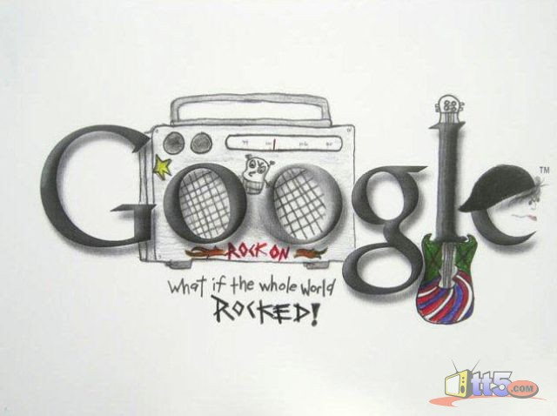
Logotype

Slide 8
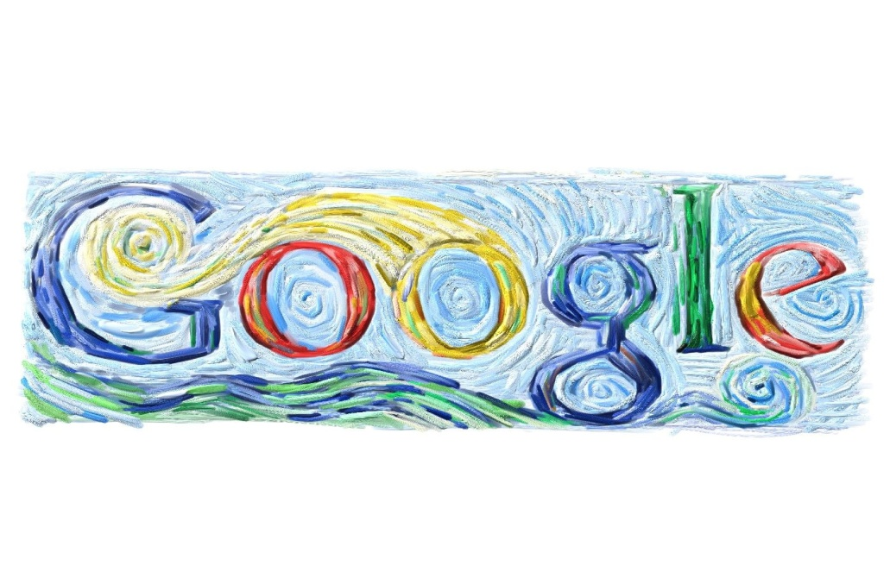
Logotype

Slide 9
Outlay
Until 2007, the largest acquisition Google considered by YouTube, bought for $ 1.65 billion in November 2006. However, April 14, 2007 the company bought DoubleClick for $ 3.1 billion in cash, which exceeds the previous largest purchase nearly doubled.

Slide 10
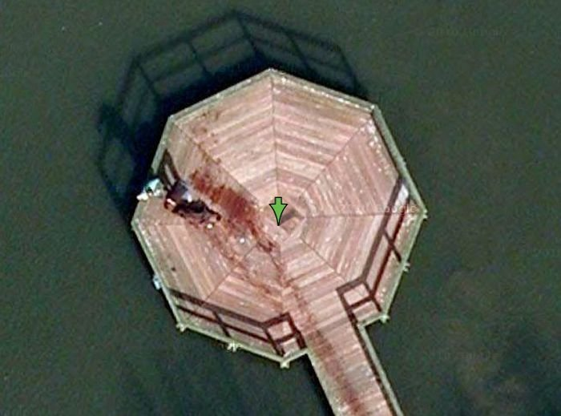
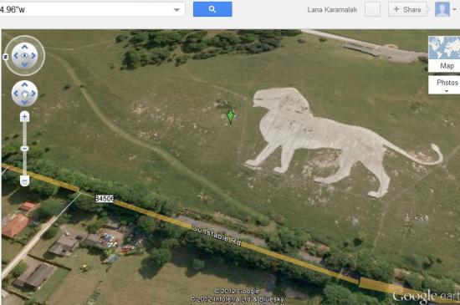
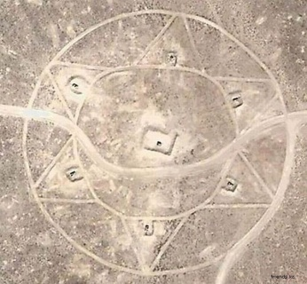
Google services
Google-Map is a set of applications that is based on free map service and technology provided by the company «Google»
загадочные места

Slide 11
Google services
YOUTUBE-is hosting providing video service.
70% of registered YouTube users are from the USA, 50% of YouTube users are under 20 years old.
You need more than 1,000 years to watch all the videos on Youtube
If, during downloading videos, you click the button up, down, left or right, then turn on the game "Snake“ will turn on.

Slide 12
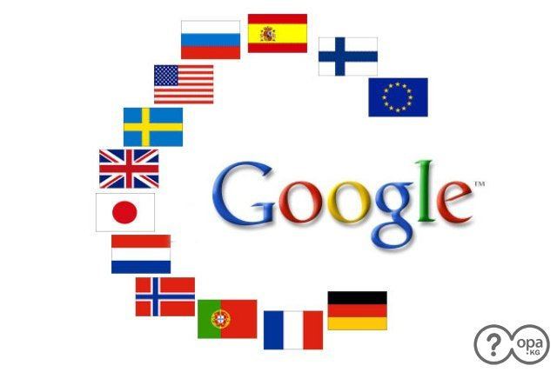
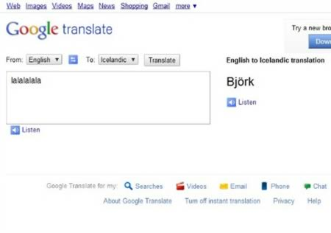
Google services
Google Translate-web service of Google, is designed to translate a piece of text or web page on into another language.
There is a special phrase «pv zk bschk pv zk pv bschk zk pv zk bschk pv zk pv bschk zk bschk pv bschk bschk pv kkkkkkkkkk bschk». It must be put into Google's translate and translate from any language to German, then click the button to listen Beatbox.

Slide 13
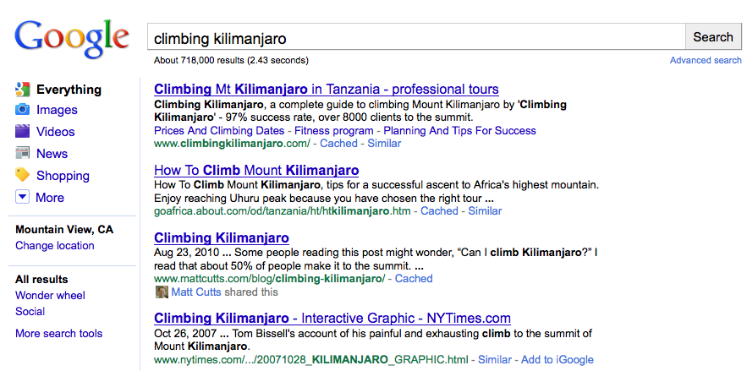
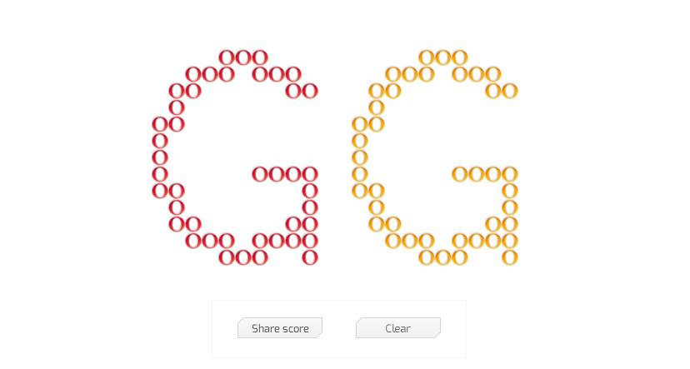
Interesting Facts
If you enter a famous phrase «Do a barrel roll», that in some browsers the Page will be overturned 360 degrees.
Enter «tilt» and the Page will be bend slightly, but still links continue to work.
While you search pictures you can game “Breakout”, entering «atari breakout»

Slide 14
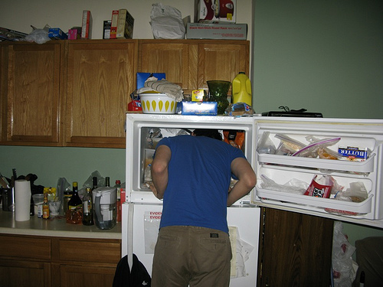
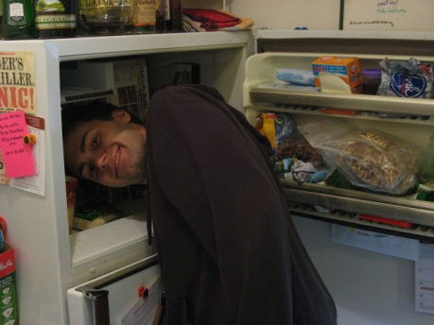
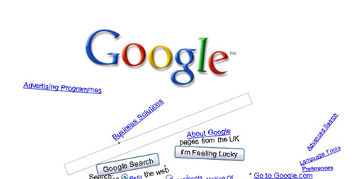
Interesting Facts
If you enter pictures "241543903“ in sefrch, you can see pictures of people putting their heads in the freezer.
You can also "play" with the elements, including gravity on the main page Google, and all the elements remain functional.

Slide 15
«To be the best is not the point, but only the beginning for us.»GOOGLE

