Slide 1
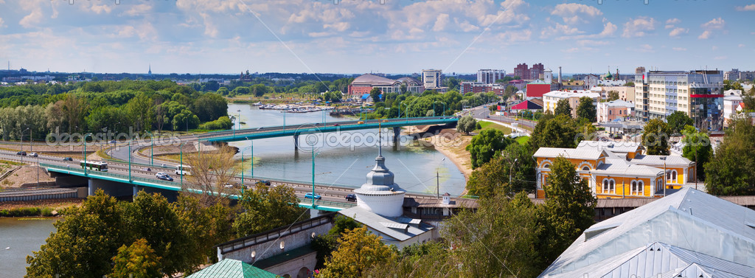
Kirov district

Slide 2
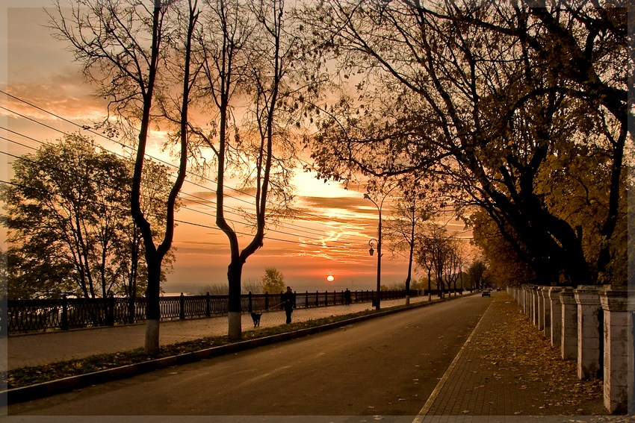
Location
Kirov district is located in the center of Yaroslavl.

Slide 3
Population
The population of the Kirov District is 55,906 of people.
In the Kirov district live people of many nationalities.

Slide 4
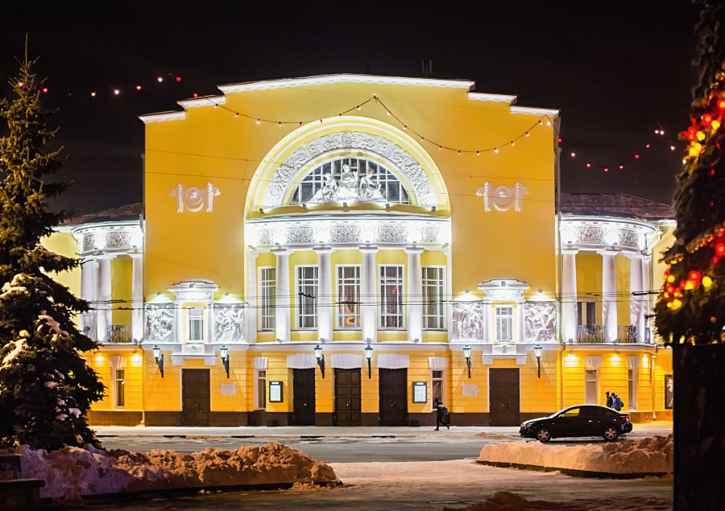
Theatre
The theatre of Fyodor Volkov is located in the Kirov district. It is the oldest Russian drama theatre, founded in 1750.

Slide 5
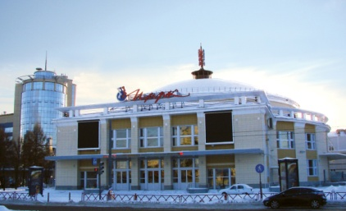
Circus
Yaroslavl Circus is situated on the area of Labor. It was the first winter circus in Yaroslavl. In 2011 has happened the opening of the restored circus.

Slide 6
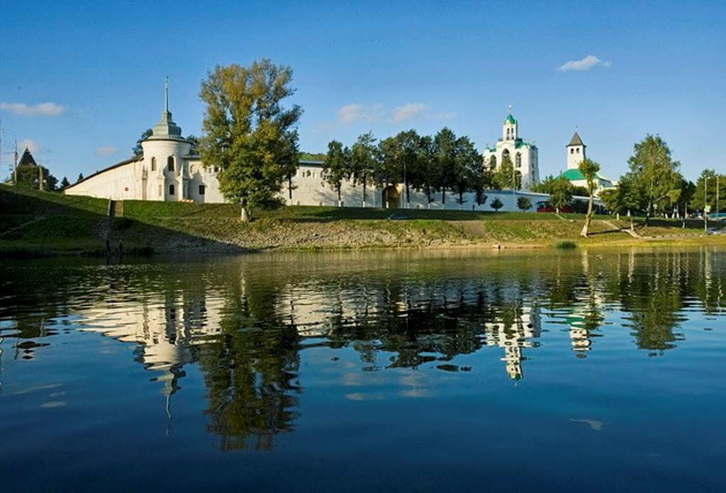
Spaso-Preobrazhensky Monastery
Spaso-Preobrazhensky Monastery – an ancient monastery in Yaroslavl, which occupies an important role in local history.

Slide 7
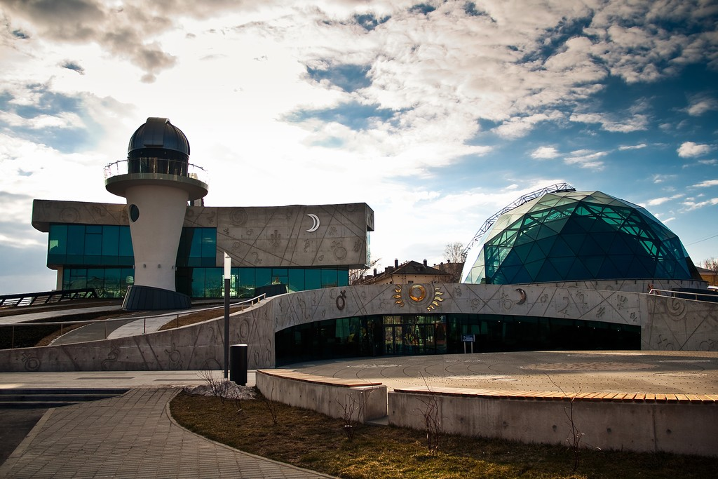
Planetarium
Planetarium is one of the main attractions of the Kirov district. There everyone can see the true beauty of the starry sky.

Slide 8
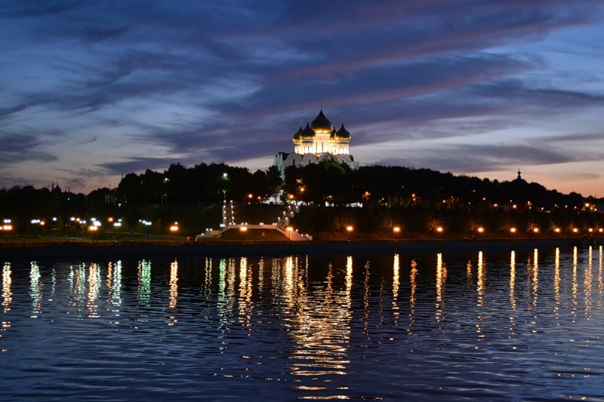
Volga
A beautiful promenade (набережная) located on the right bank (берег) of the Volga River.

Slide 9
Goodbye

