Slide 1
The first, the best, Russian
Yuri Gagarin

Slide 2
Yuri Alekseyevich Gagarin (9 March 1934 – 27 March 1968) was a Soviet pilot and cosmonaut.
Yuri Gagarin was born in the village of Klushino. His parents worked on a collective farm. Yuri was the third of four children.

Slide 3
After graduating from the technical school in 1955, the Soviet Army drafted Gagarin. On a recommendation, Gagarin was sent to the First Chkalov Air Force Pilot's School in Orenburg, the Soviet Army drafted Gagarin.
In 1960, after much searching and a selection process, Yuri Gagarin was chosen with 19 other pilots for the Soviet space program.

Slide 4
On 12 April 1961, aboard the Vostok 1, Gagarin became both the first human to travel into space, and the first to orbit the earth. His call sign was Kedr.
After the command "at the start," Gagarin said famous phrase: "Let's go!".
Gagarin.avi

Slide 5
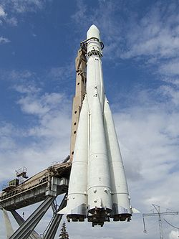
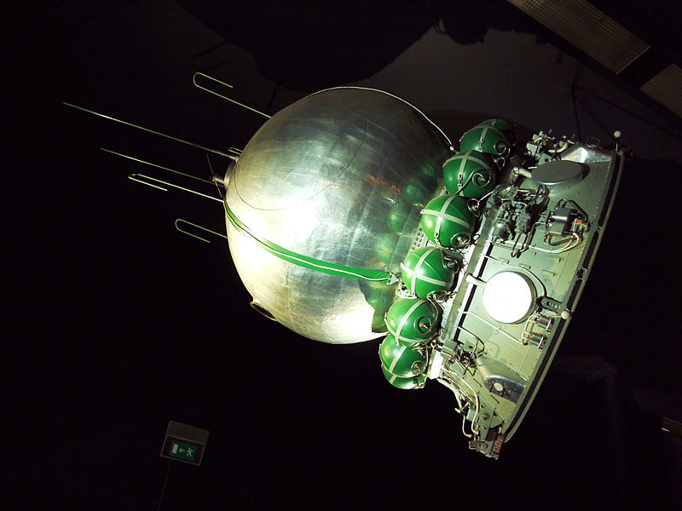
On orbit Gagarin spent simple experiments: drinking, eating, writing in a notebook.

Slide 6
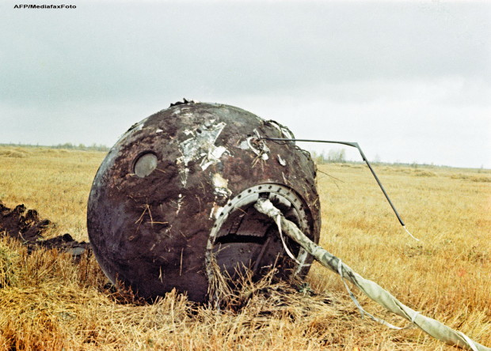
After completing one revolution around the Earth, the ship completed the flight.

Slide 7
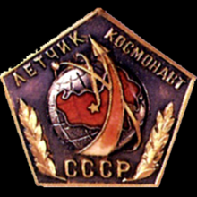
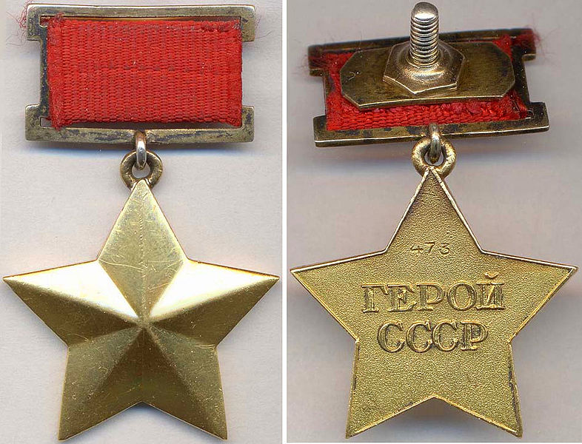
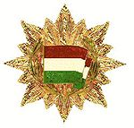
Yuri Gagarin received numerous medals and honors.
March 27, 1968 Gagarin died in a plane crash by performing a training flight.

