Slide 1
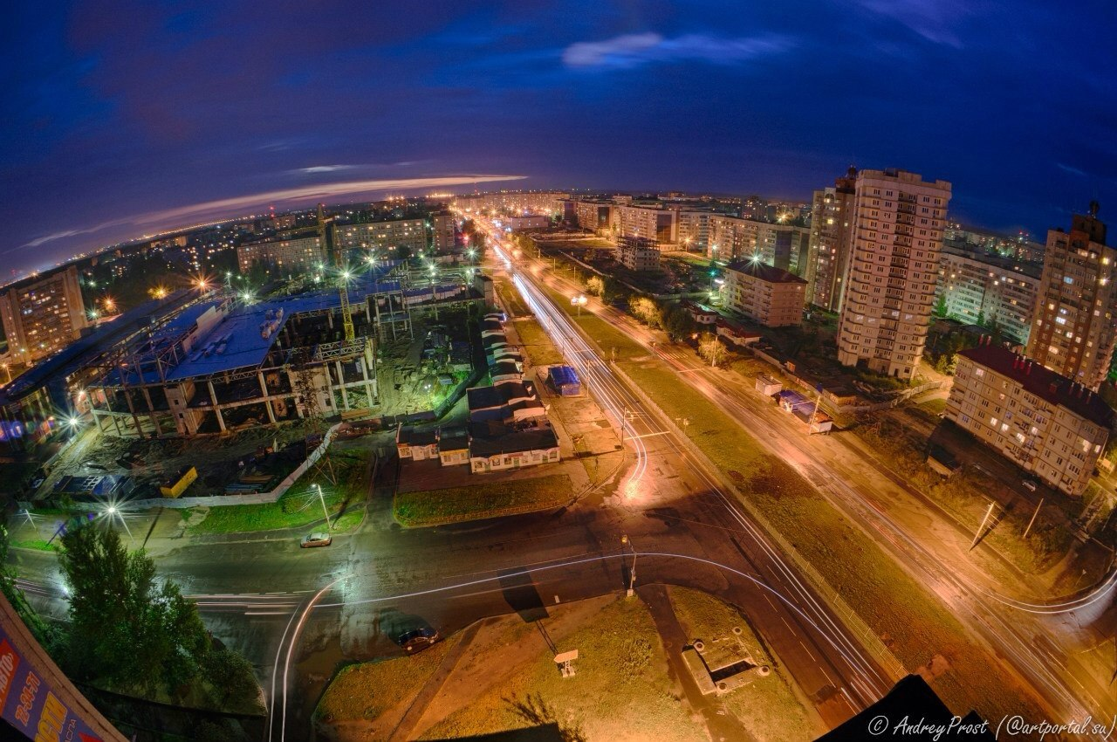
Zavolzhsky district

Slide 2
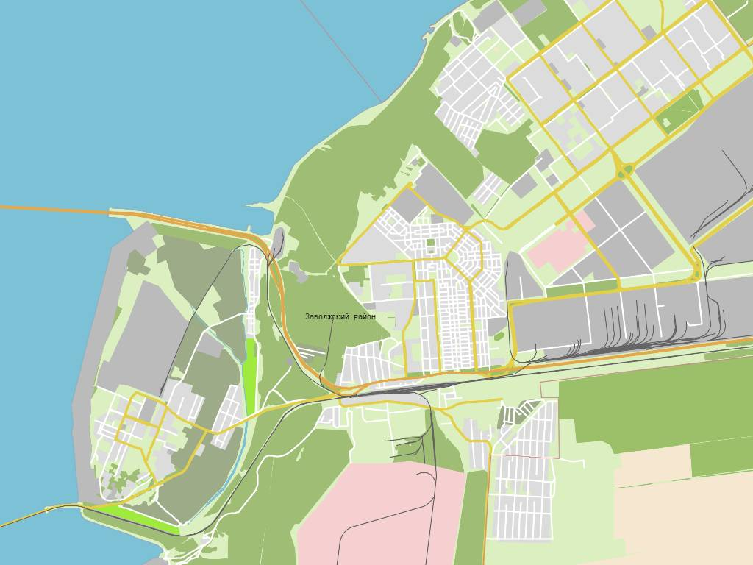
Zavolzhsky district is located in the city of Yaroslavl, in the north-west part of town.
He near the city center.

Slide 3
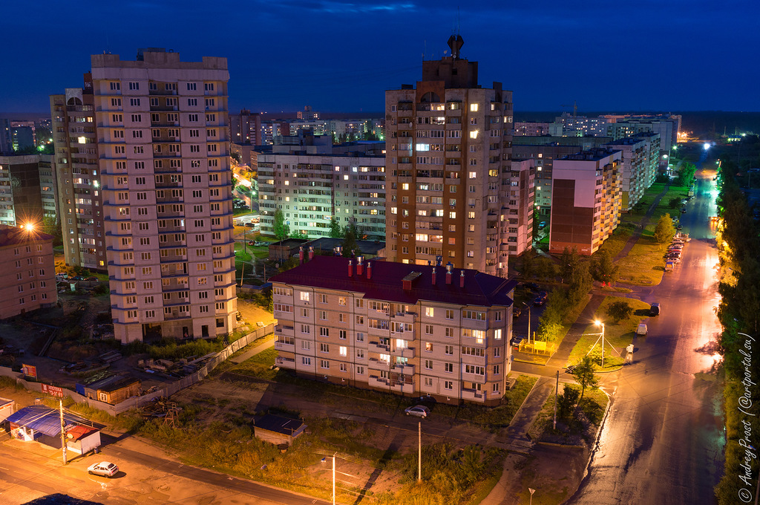
Russian language.
Population: 119 225 people.

Slide 4
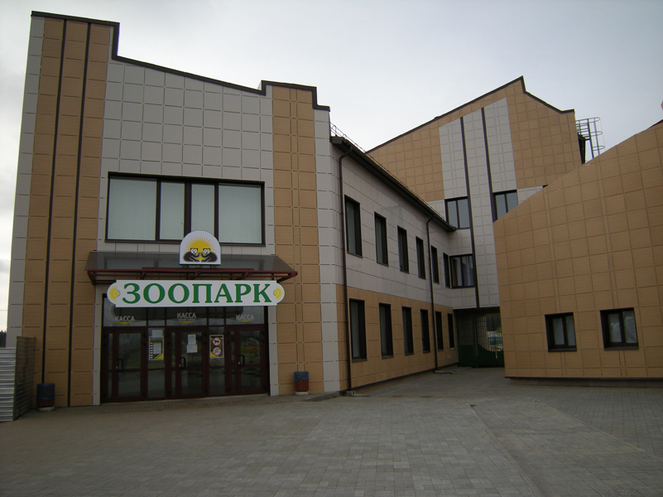
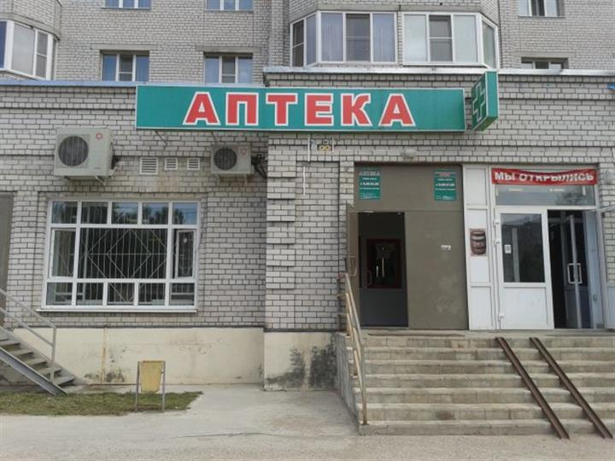
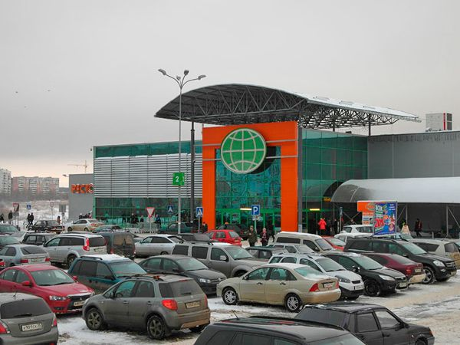
In Zavolzhsky district 16 secondary schools, driving schools 6, 3 cinemas, 8 shopping malls, 11 cafes and restaurants, 8 hotels, 11 pharmacies, 9 ATMs and twelve stores with products.
There is also a zoo Yaroslavsky and children's railway.

Slide 5
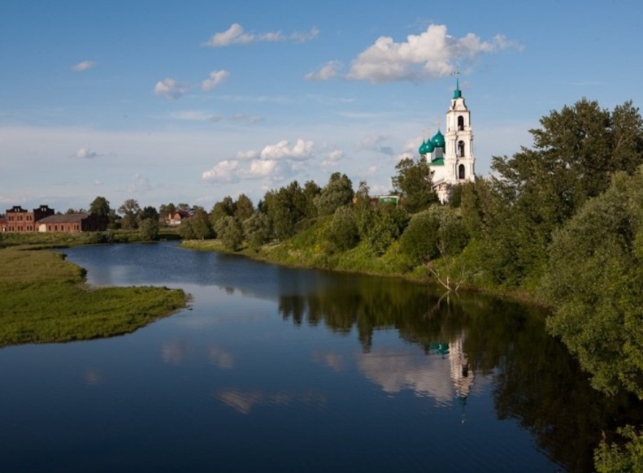
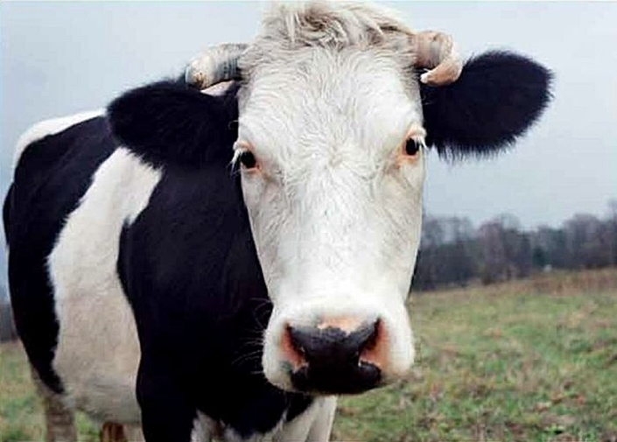
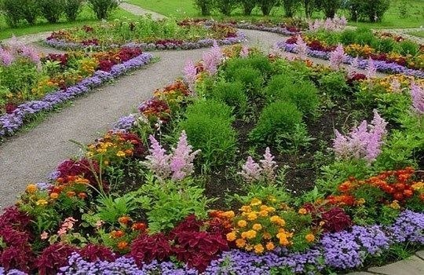
Volga river
Animals: fox, horse, pig, a cow; there are pet stores that sell pets.
Plants: oak, birch, fir, pine, maple, tulips, bluebells, daisies, orchids and so on ...

Slide 6
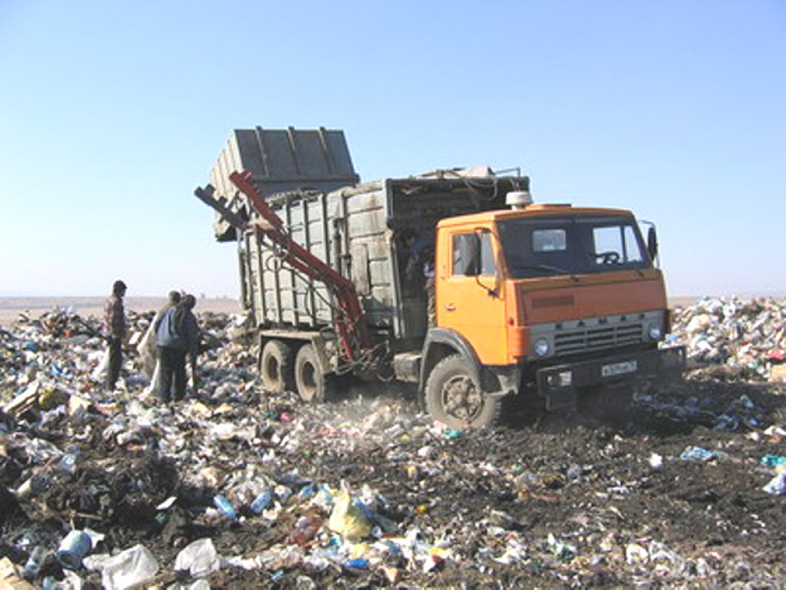
In Yaroslavl, 15 landfills.
2 processing plants: Vtortsvetmet and complex processing of timber.
2 Organization for hauling garbage and waste: TehPromResurs and Delta Company.

Slide 7
Thank you for attention!

