Slide 1
Quiz
GREAT BRITAIN
Notes:
Quiz
Britain and Yamal

Slide 2
1.The official name of Great Britain is:
The British Federation
The United Kingdom of Great Britain and Northern Ireland
с) The United Kingdom of Great Britain

Slide 3
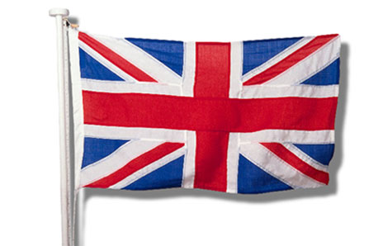
The United Kingdom of Great Britain and Northern Ireland

Slide 4
3.Great Britain consists of four parts:
a) England, Scotland, Wales and Northern Ireland
b) London, Belfast, Cardiff and Edinburgh
c) English, Scottish, Welsh and Irish

Slide 5
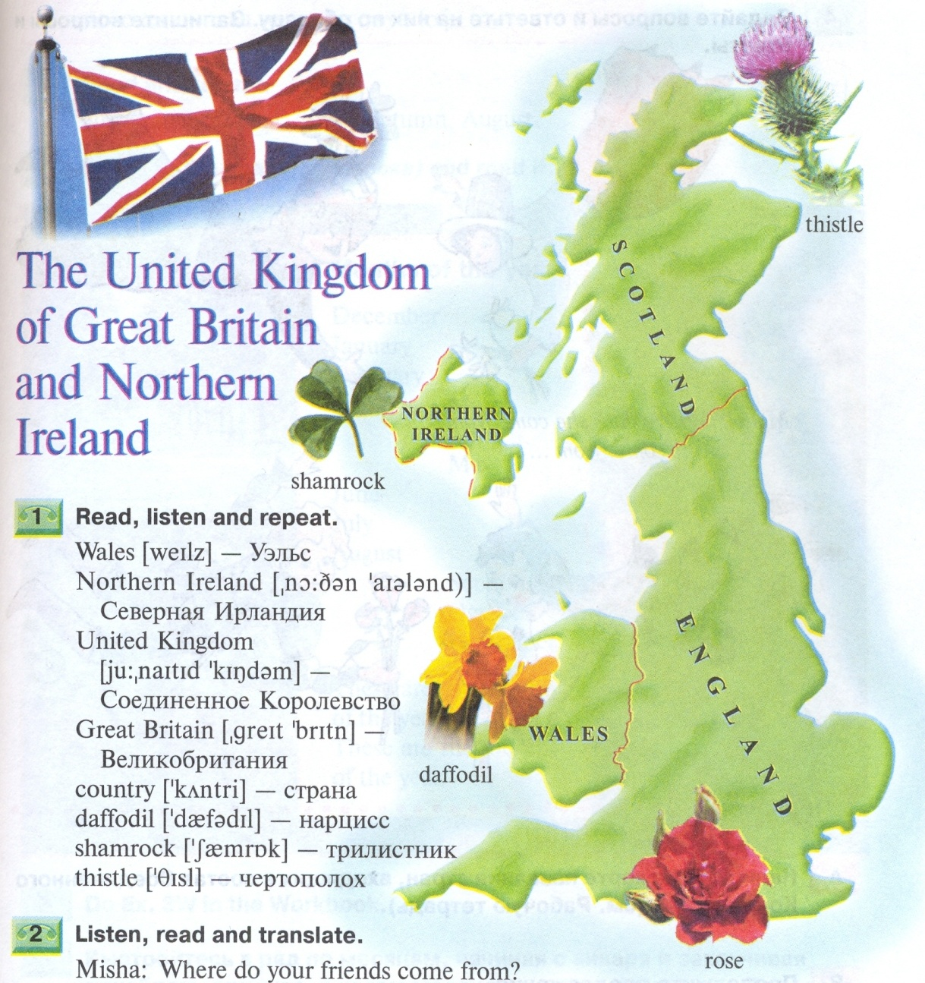
England, Scotland, Wales and Northern Ireland

Slide 6
5. The political system in Great Britain is:
parliamentary monarchy
democratic republic
parliamentary republic

Slide 7
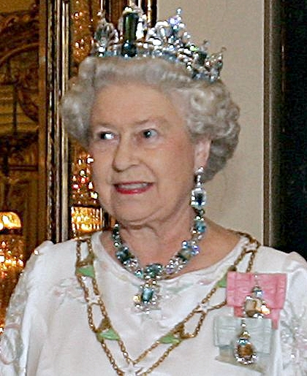
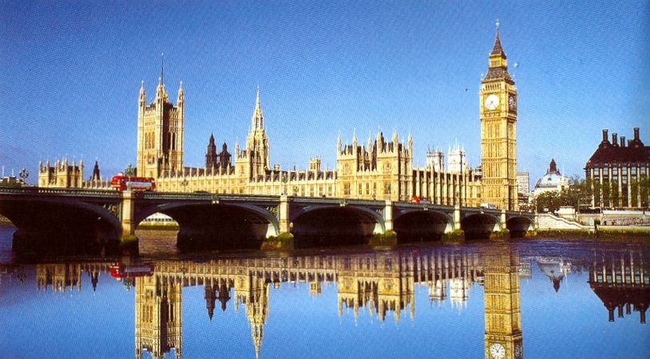
parliamentary
monarchy

Slide 8
7. The British Queen’s name is…
Victoria
Diana
c) Elizabeth

Slide 9
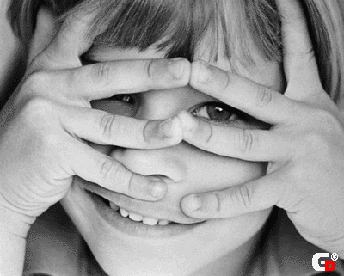
Elizabeth

Slide 10
9. The official residence of Prime Minister is …
13, Fleet Street
10, Downing Street
12, Baker Street

Slide 11
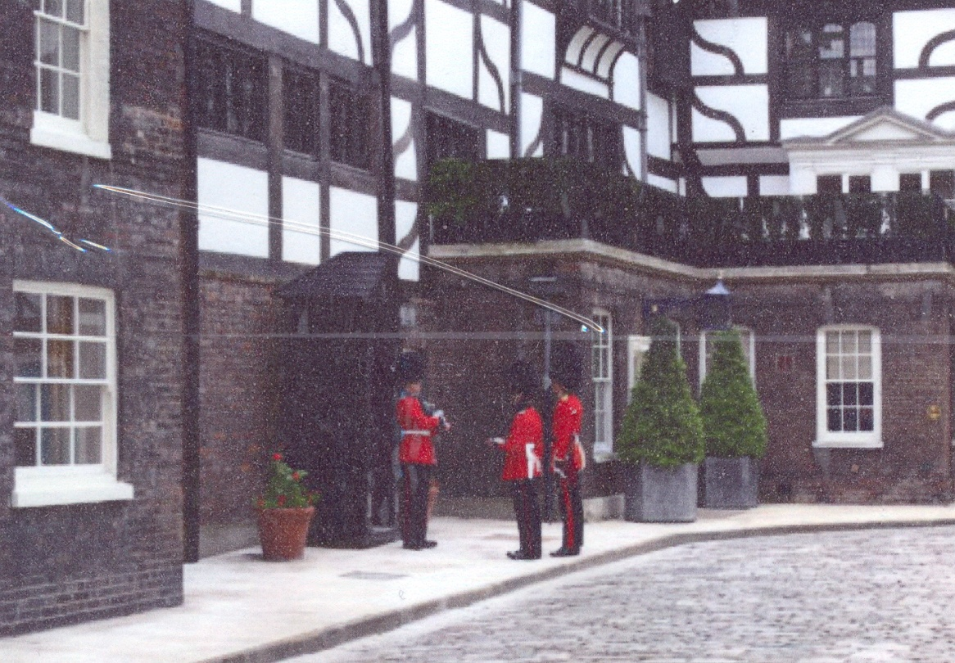
10, Downing Street

Slide 12
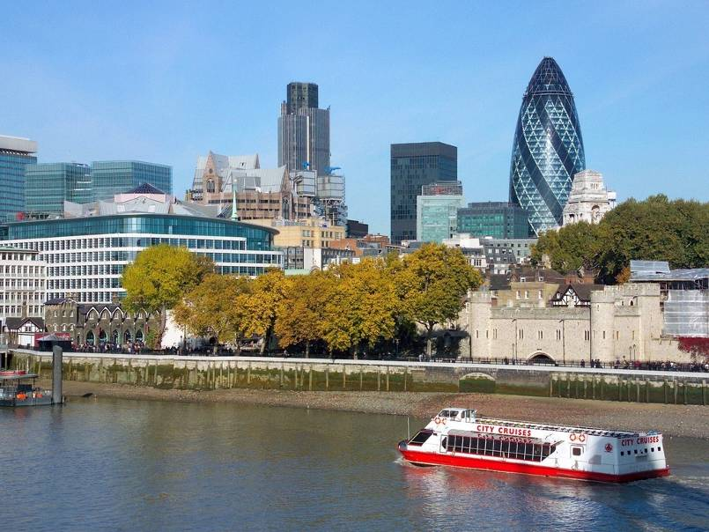
11. The longest river in Great Britain is …
the Severn
the Reihn
the Thames

Slide 13
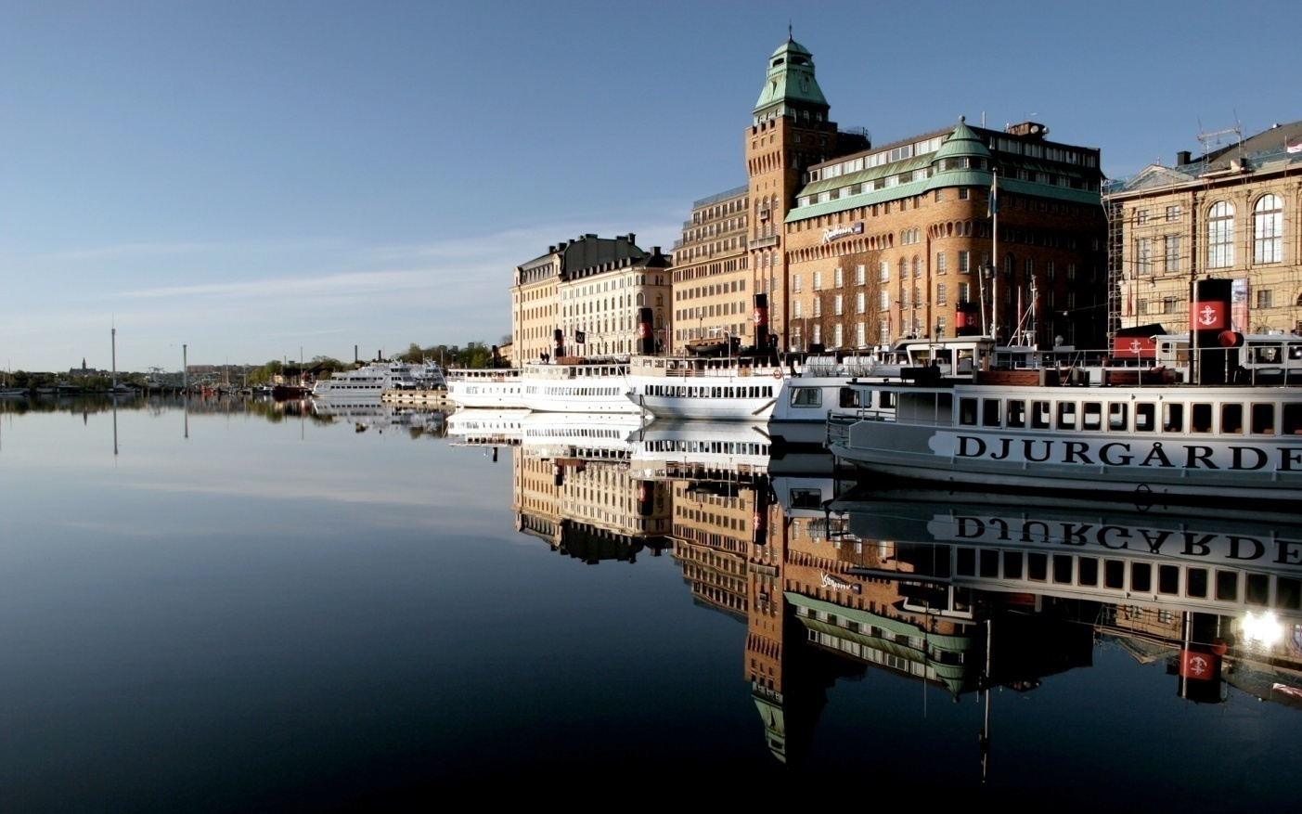
t
n
h
e
r
S
e
e
v

Slide 14
13. Smog is …
the result of air pollution
just a kind of fog
the smoke of a big cigar

Slide 15
the result of air pollution

Slide 16
15. London is famous for its parks. Could you tell, which of the following parks isn’t located in London?
Hyde Park
Madison Square Garden
Festival Gardens

Slide 17
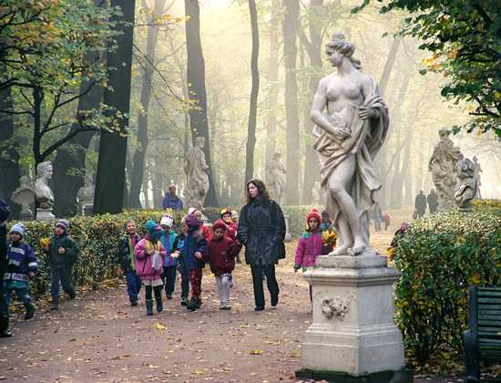
Madison Square Garden

Slide 18
17. The famous clock is called “Big Ben” after …
Benjamin Franklin, the President
Benjamin Hall, the constructor
Ivan Kulibin, the inventor

Slide 19
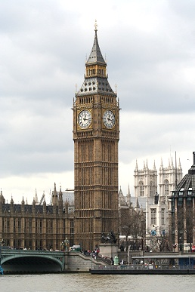
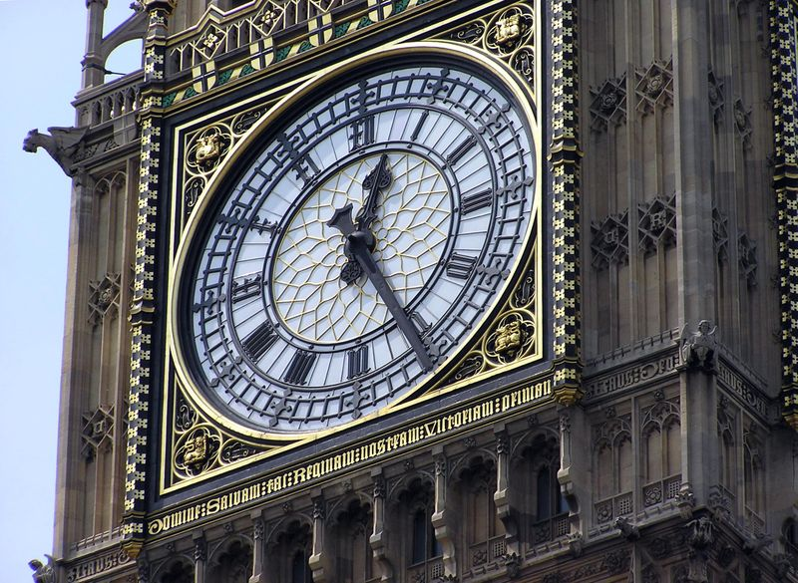
Benjamin Hall,
the constructor

Slide 20
19. This building was a castle, then a palace, after that a prison for the kings, and now it’s a museum. What is it?
Westminster Abbey
The Tower
Madam Tussaud’s Museum

Slide 21
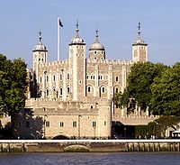
The Tower

Slide 22
21. This traditional British food is considered (считают) to be the first “fast food”. It’s …
porridge
Cornish meat pie
chicken and chips

Slide 23
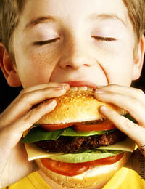
Cornish meat pie

Slide 24
23. What is Heathrow?
a bank
a department store
an airport

Slide 25
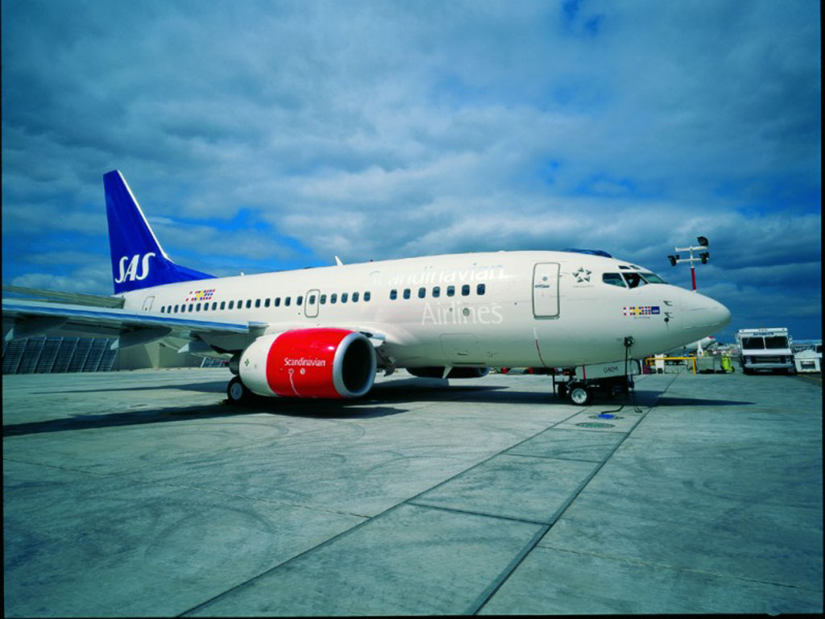
an airport

Slide 26
25. How many pence are there in 1 pound sterling?
25
50
100

Slide 27
1penny
1penny
1penny
1penny
100 pence
11 penny00

Slide 28
27. What is Loch Ness?
a river
a lake
a monster

Slide 29
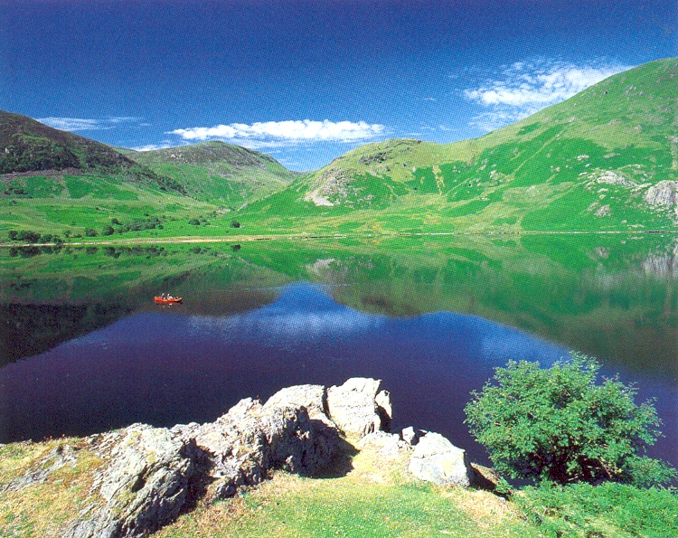
a lake

Slide 30
29. It’s a national sport of the Welsh
rock climbing
football
rugby

Slide 31
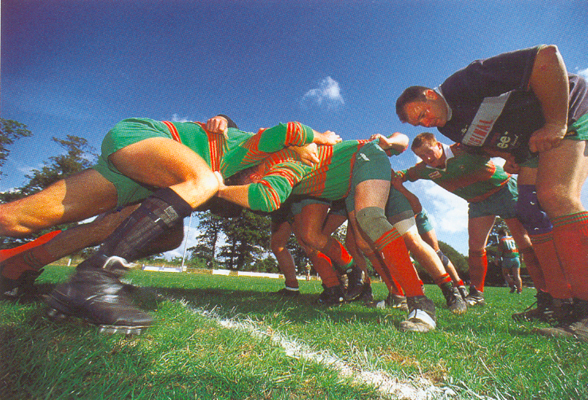
rugby

